Slide 1

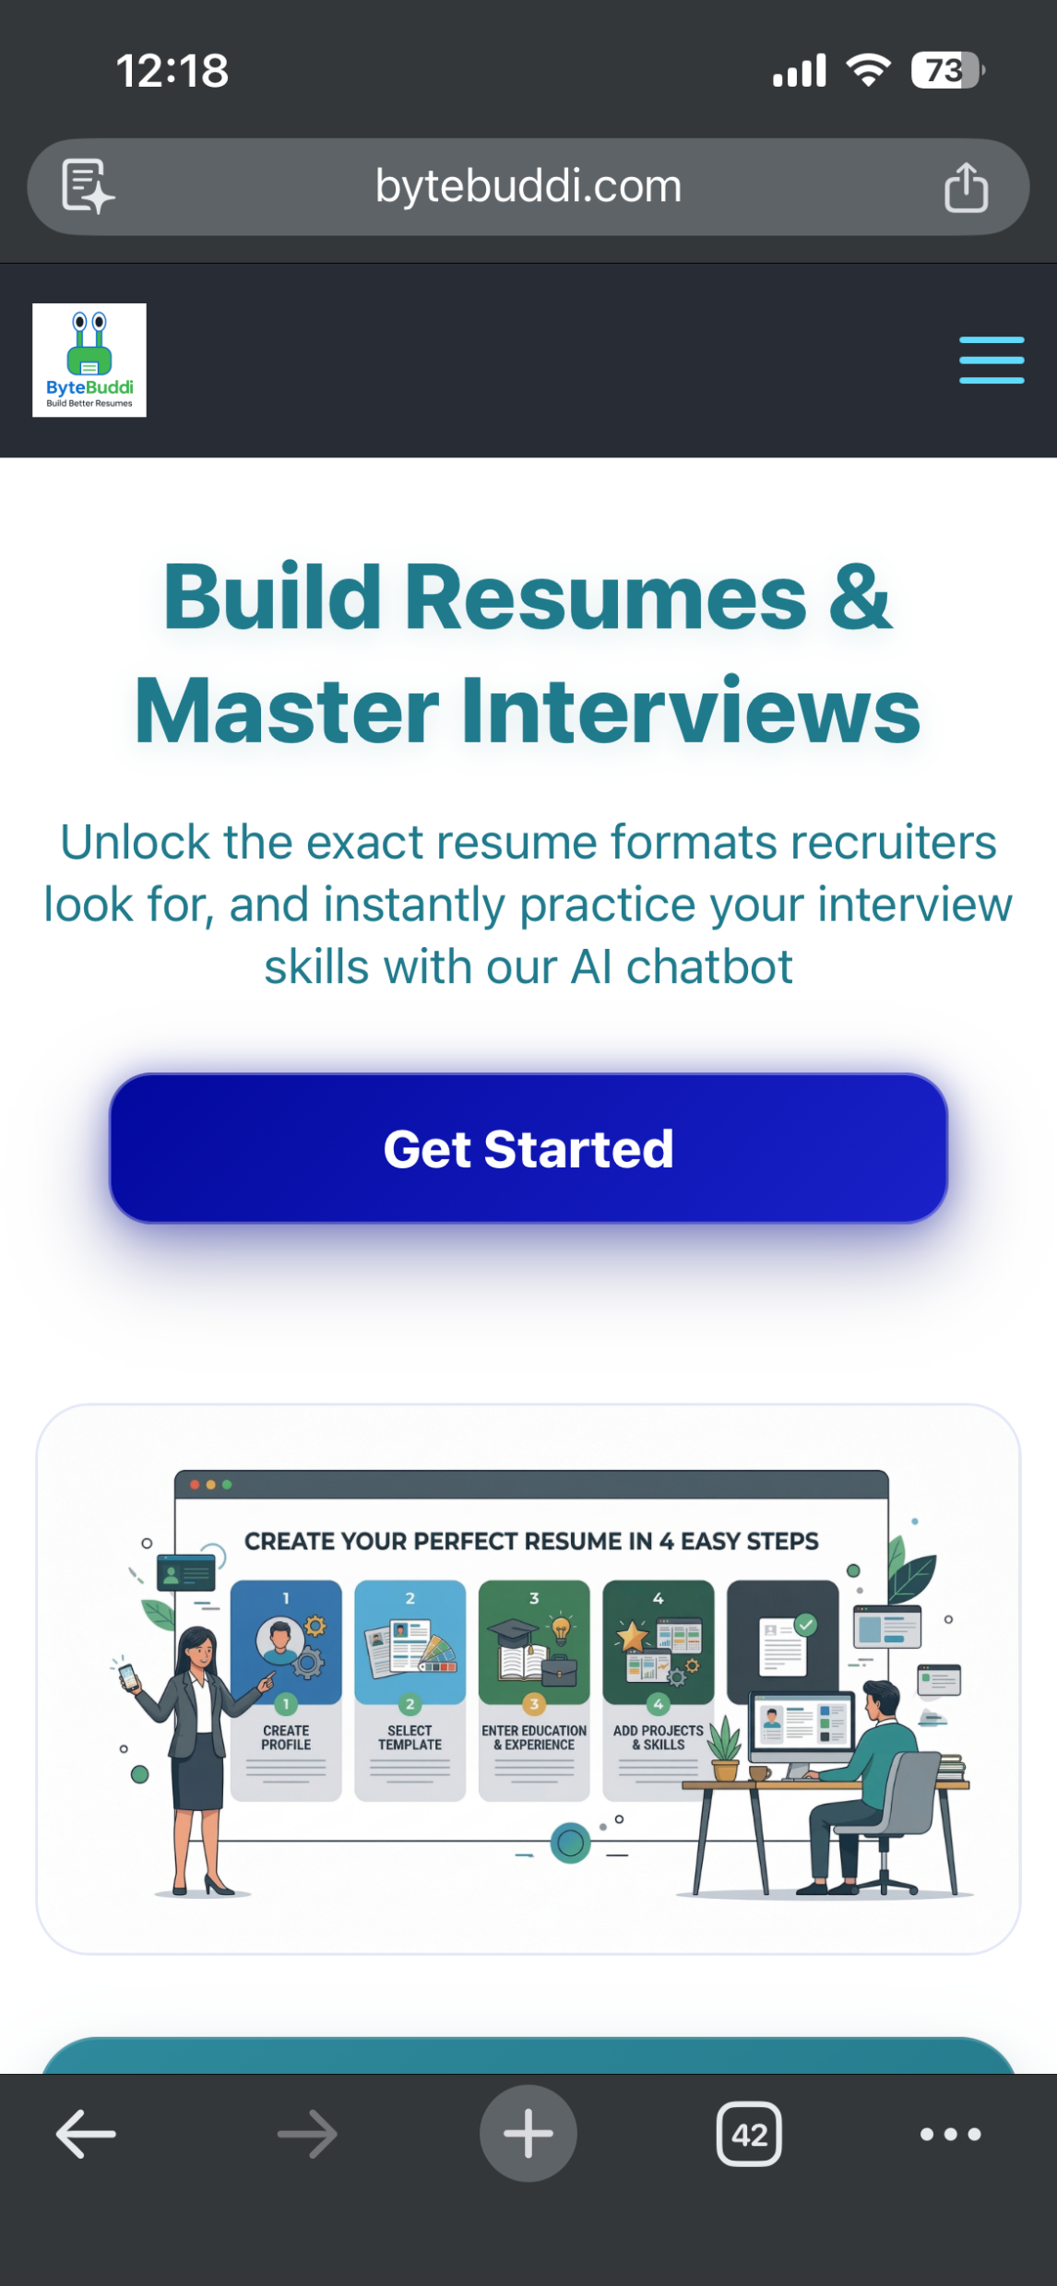
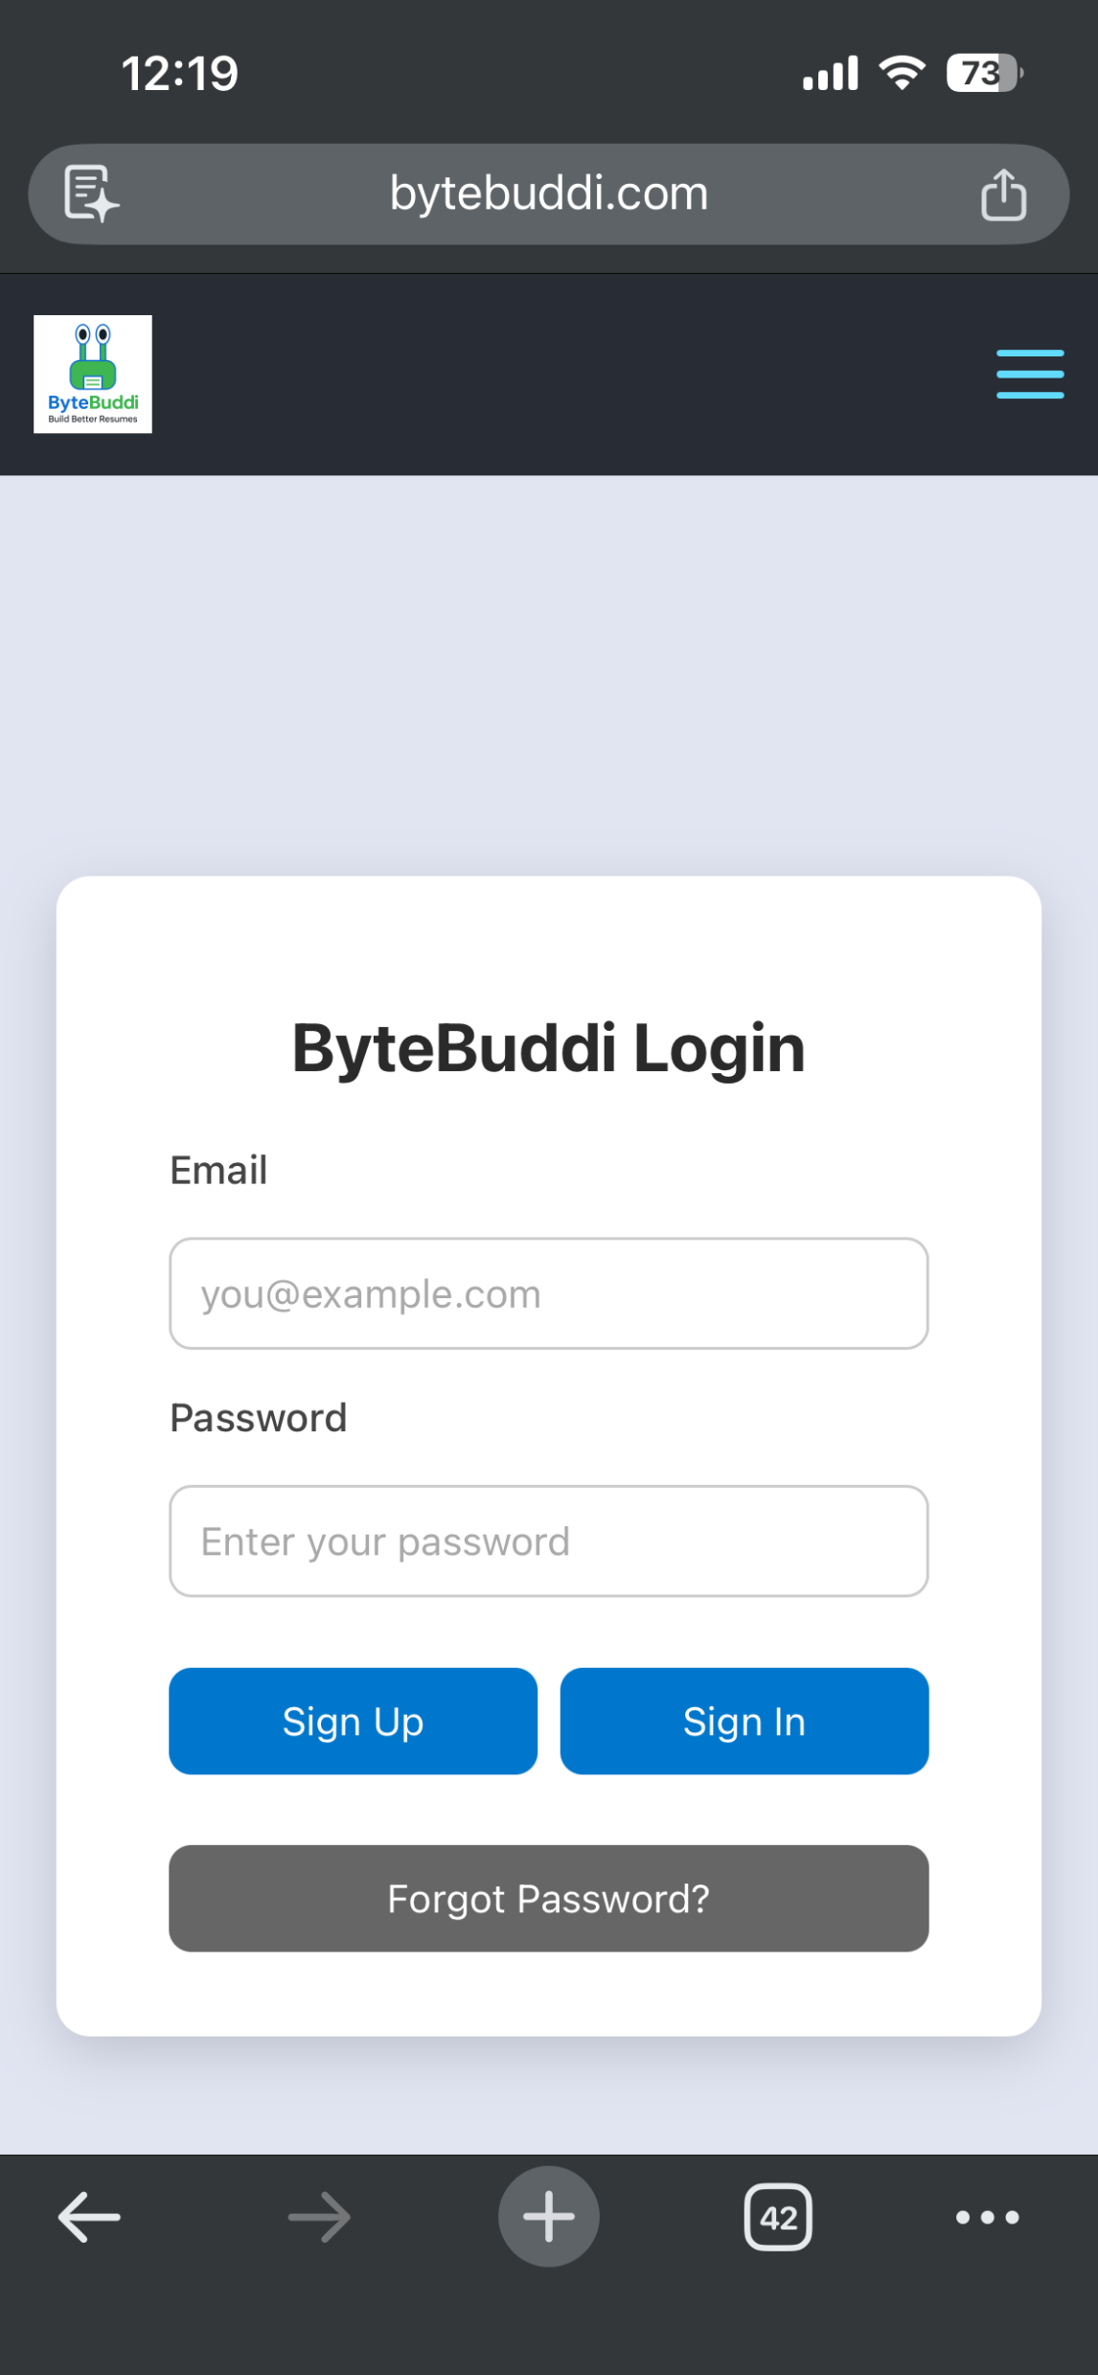
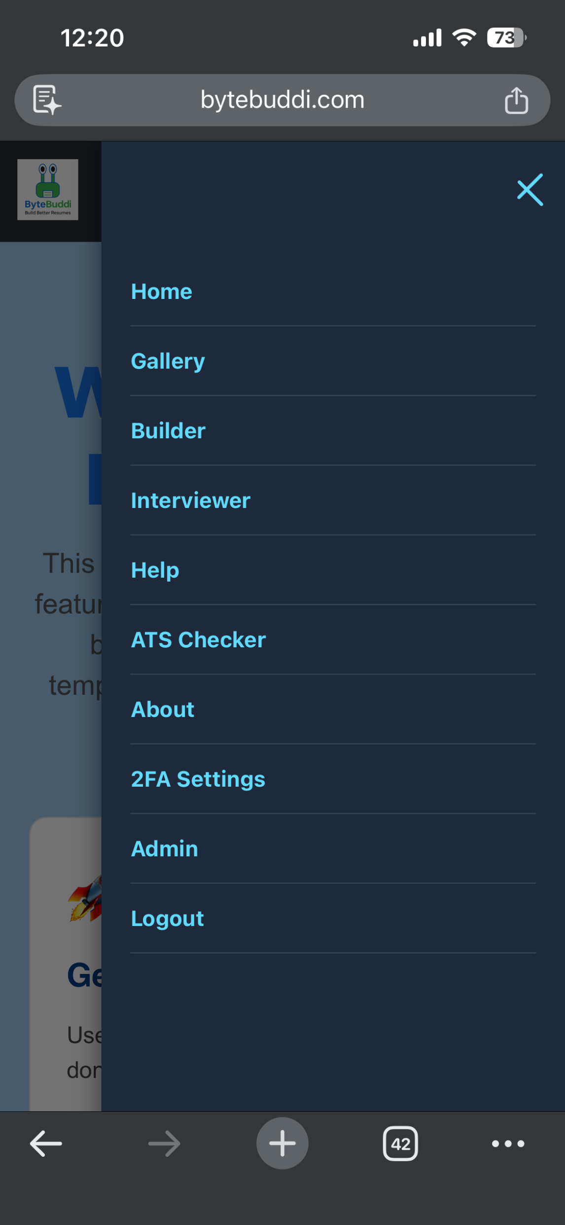
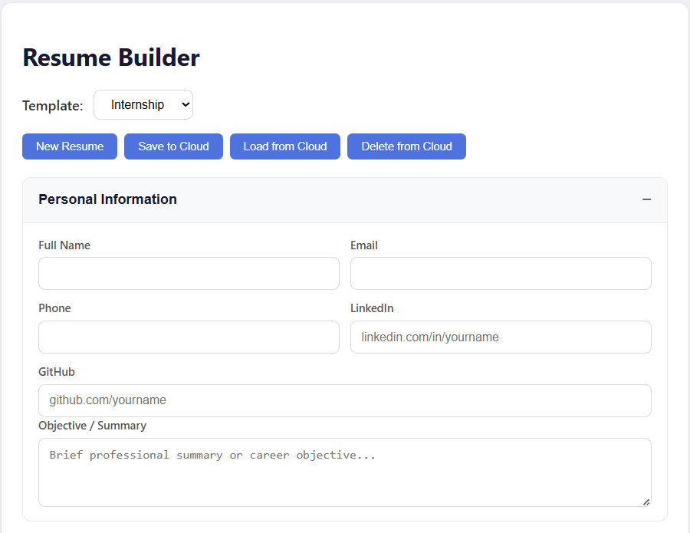
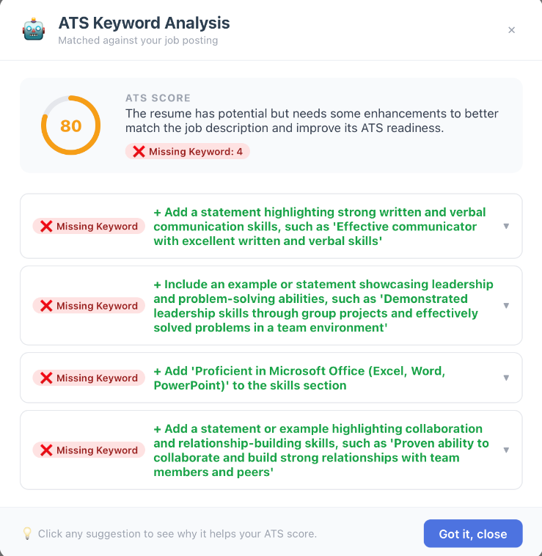

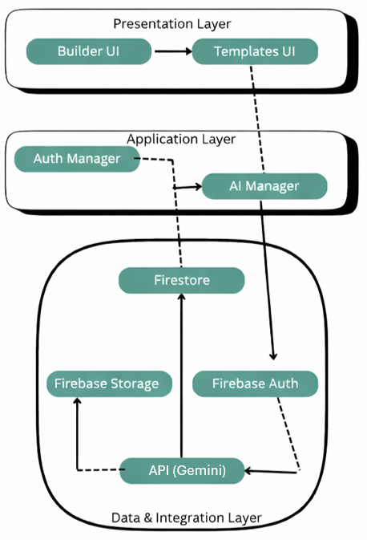
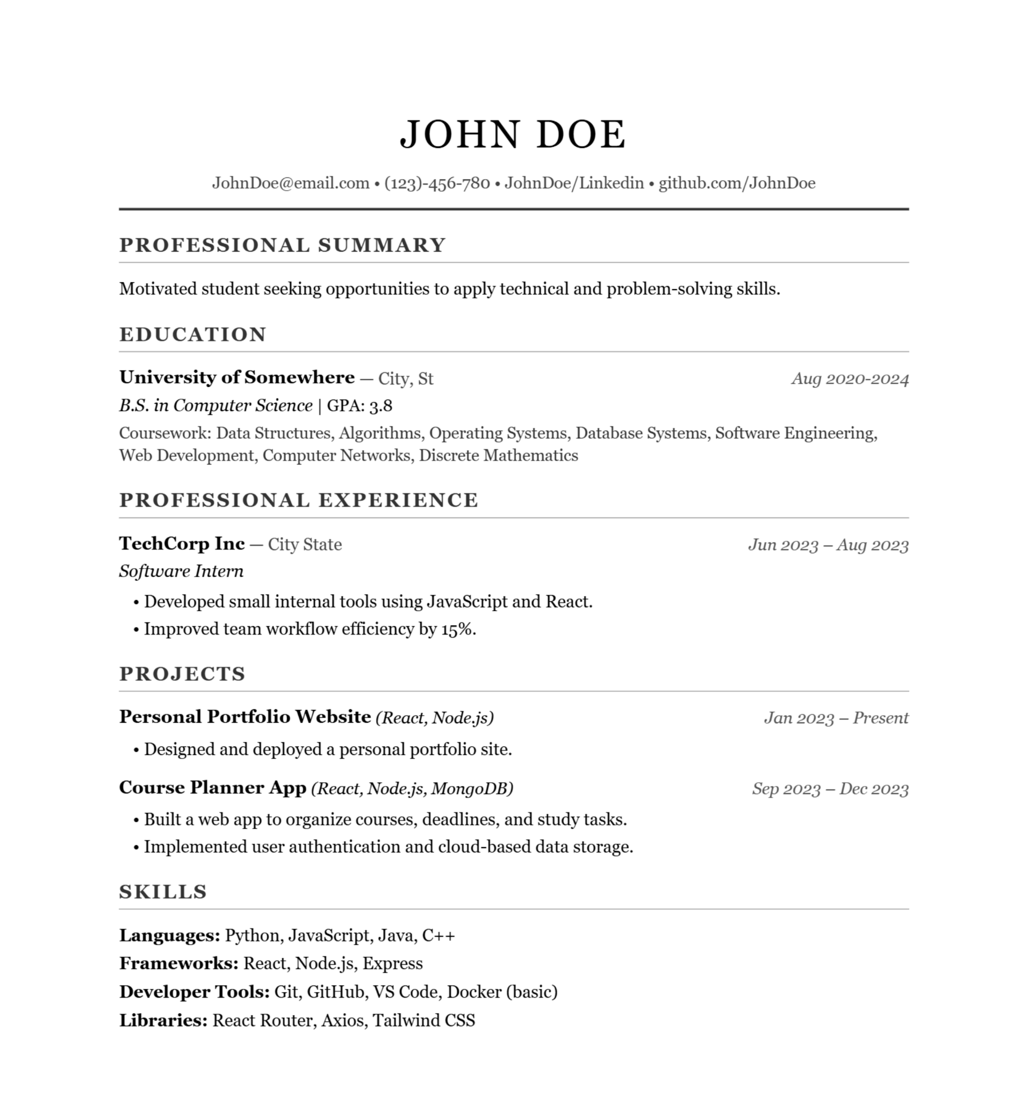
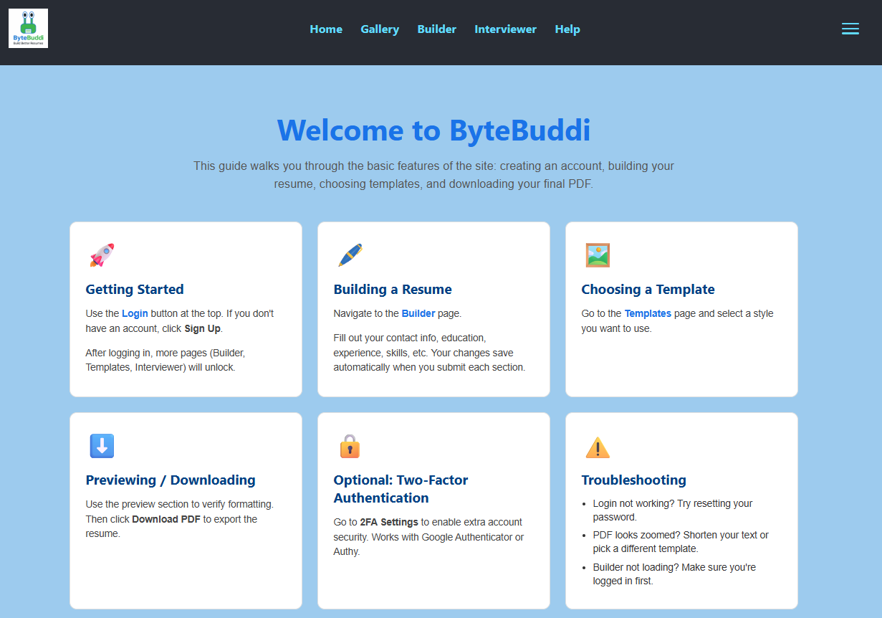
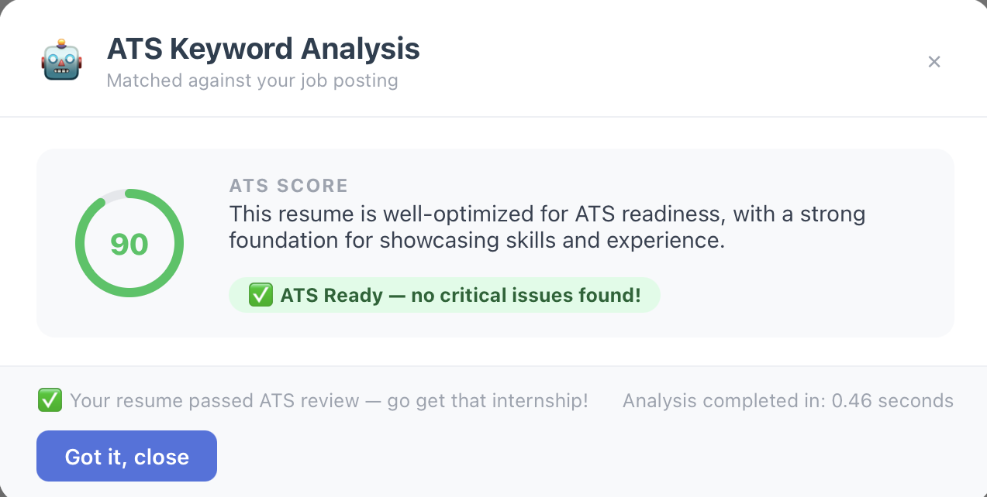
ByteBuddi Automated Resume Builder
CSE Senior Design
Everly, Adalynn; Davis, Ryan; Salazar, Rene; Gallegos, Cesar; Acevedo, Alan; Lopez, Xavior
Executive Summary
Experimental Setup
Experimental Results
Web app for building resumes with guided templates
Includes login, builder, template gallery, and ATS keyword checker
ATS checker compares a job description to the resume and suggests missing keywords
Goal is faster resume creation with better job matching
Tested using multiple software internship job descriptions
Compared suggested keywords against template resume content
Validated core flows: login, template selection, edits, ATS checking
Checked usability on desktop and mobile screen sizes
Verified hosting and data persistence in the deployed environment
Template selection and resume preview work correctly
ATS checker generates a score and missing keyword suggestions
Core pages load reliably during typical user flows
Remaining work: improve mobile layout, tighten responsiveness, standardize deployment steps
Background
Experimental Test Plan
Conclusions
Many resumes do not match job posting language, which hurts ATS visibility
Students often struggle with formatting and describing skills clearly
ByteBuddi combines structured templates with keyword feedback to help users tailor resumes
Test categories
Account creation and login
Template selection and rendering
Resume editing and export
ATS checker job description input and analysis output
Cross browser testing
Mobile responsiveness testing
Deployment validation
Success criteria
Users can complete a resume workflow without errors
ATS checker returns a score and keyword suggestions
Pages render correctly on common screen sizes
No blocking bugs in core flows
ByteBuddi supports resume building with job specific keyword guidance
Current build works end to end for the core workflow
Next steps: mobile polish, deployment consistency, broader testing coverage
References
1. Groq API Docs: https://console.groq.com/docs 2. Firebase Auth State Persistence: https://firebase.google.com/docs/auth/web/auth-state-persistence 3. Cloud Firestore Docs: https://firebase.google.com/docs/firestore/query-data/get-data 4. Firebase Hosting Docs: https://firebase.google.com/docs/hosting 5. React Docs: https://react.dev 6. React Router Docs: https://reactrouter.com/en/main

